Slide 1

Class IV: Transcriptomics
Evolutionary and Quantitative Genetics 2020-2021
Dr. Janne Swaegers
Laboratory of Evolutionary Stress Ecology
and Ecotoxicology, KU Leuven
Ch. Deberiotstraat 32, B-3000 Leuven
Phone: +32 16 32 39 66,
E-mail: janne.swaegers@kuleuven.be

Slide 2
WHICH GENES UNDERLIE VARIATION IN ADAPTIVE TRAITS?
illustration by Katina Spanier, 2019

Slide 3
RNA-SEQ IN EVOLUTION & ECOLOGY
Allows functional studies that explore the specific genomic basis of phenotypic variation and rapid response to environmental change
Simultaneously measure genome-wide gene expression on large numbers of individuals
The quantification of these patterns on a genome-wide scale allows us to observe the molecular regulation of phenotype in response to ecological phenomena
Alvarez et al. 2014

Slide 4
Overview
RNA-SEQ IN EVOLUTION & ECOLOGY
Source:
Van den Berge et al., 2019

Slide 5
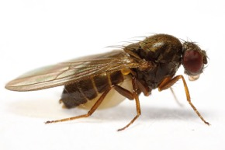
Examples
RNA-SEQ IN EVOLUTION & ECOLOGY
﻿Drosophila subobscura
sampling across its native 20° latitudinal range in Europe (11 °C difference in mean annual temperature)
six populations
identify signals of local adaptation
﻿higher latitude: enriched for metabolic processes, expressed across all tissues
lower latitude: enriched for reproductive processes, expressed primarily in testes
Porcelli et al. 2016

Slide 6
Examples
RNA-SEQ IN EVOLUTION & ECOLOGY
Colias crocea exhibits alternative life histories associated with wing color polymorphism
RNA-seq to detect candidate genes associated with alternative life histories
Woronik et al., 2019

Slide 7
RNA-SEQ IN EVOLUTION & ECOLOGY
RNA-seq in non-model species
Possible due to de novo assembly of sequencing reads
Todd et al., 2016

Slide 8
Brian Haas, 2015

Slide 9
Brian Haas, 2015

Slide 10
Brian Haas, 2015

Slide 11
Counting reads per contig
Seelbinder et al., 2019

Slide 12
Differential gene expression analysis
Brian Haas, 2015

Slide 13
Brian Haas, 2015

Slide 14
Brian Haas, 2015

Slide 15
Brian Haas, 2015

Slide 16
Brian Haas, 2015

Slide 17
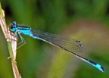
Data exploration
Lancaster et al. 2016

Slide 18
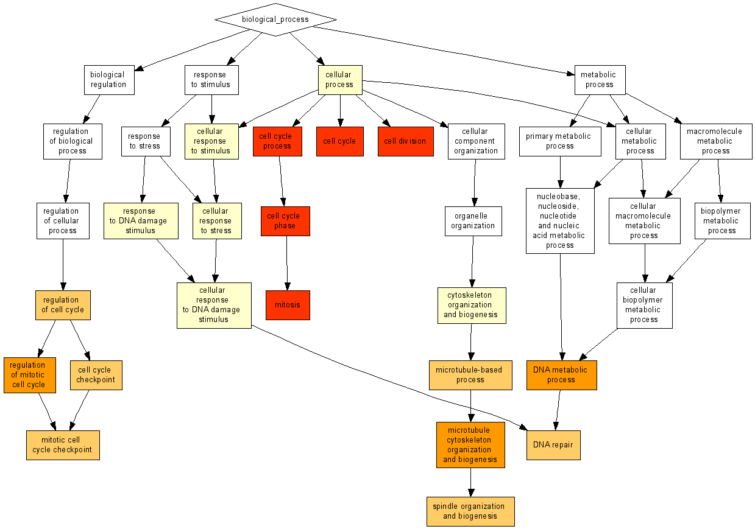

Functional analysis
Straightforward for species with annotated transcriptomes
Blast against annotated reference transcriptome
More difficult for non-model species
Blast against protein databases of closely related species
Gene Ontology
A GO annotation represents a link between a gene product type and a molecular function, biological process, or cellular component type (a link, in other words, between the gene product and what that product is capable of doing, what biological processes it contributes to, and where in the cell it is capable of functioning in the natural life of an organism)
Hill et al., 2008

Slide 19
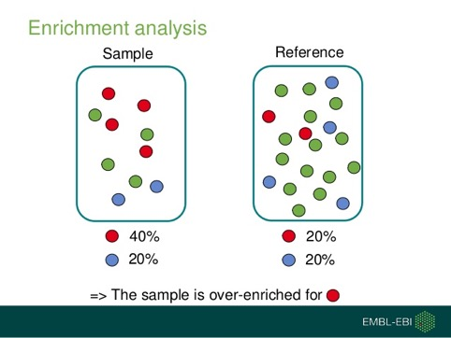
Functional analysis
Gene Ontology Enrichment analysis
Given a set of genes that are e.g. up-regulated under certain conditions, an enrichment analysis will find which GO terms are over-represented (or under-represented) using annotations for that gene set

Slide 20
Your compass to this class
Aim
Understanding the basics of transcriptomic analysis and why it is useful in evolutionary biology
Get acquainted with the nature of RNA-seq data
Milestones
Installing R packages and importing data
Exploring RNA-seq data
Executing differential gene expression analysis
Tools
R package DESeq2

Slide 21
Dataset Computer Lab

Slide 22
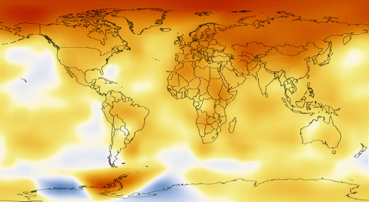
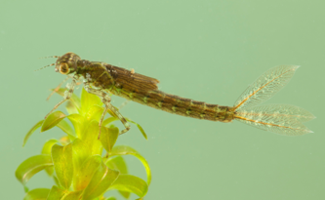
Exercise
UNDERLYING MECHANISMS OF RESPONSE TO GLOBAL WARMING IN A DAMSELFLY USING A SPACE-FOR-TIME APPROACH
published in Molecular Ecology, 2020: https://onlinelibrary.wiley.com/doi/abs/10.1111/mec.15676

Slide 23
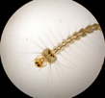
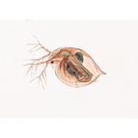

HOW TO PREDICT THE RESPONSE TO GLOBAL WARMING?
Re-analyse populations
TIME
TEMPERATURE
Dormant stages

Slide 24
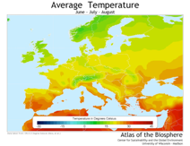
HOW TO PREDICT THE RESPONSE TO GLOBAL WARMING?
Most environmental factors that vary in time also vary in space
Compare populations between latitudes
Allows to make inferences about future response of high-latitude populations
SPACE
TEMPERATURE

Slide 25
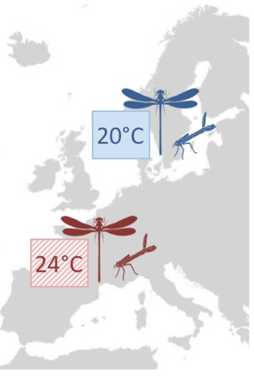
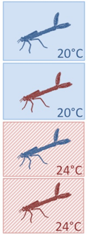
HOW TO PREDICT THE RESPONSE TO GLOBAL WARMING?
Common garden
Pattern of the high-latitude populations at the low-latitude temperature : gives idea about the response in the absence of gradual thermal evolution
Pattern of the low-latitude populations at the low-latitude temperature: gives idea about the response in the presence of gradual thermal evolution
Space-for-time

Slide 26
THERMAL REACTION NORMS
Describes pattern of phenotypic expression of a genotype across a range of environments
How do different populations respond to varying environments?

Slide 27
THERMAL REACTION NORMS

Slide 28
GENE EXPRESSION
Characterization of the reaction norm for all genes in the transcriptome across treatments
Assess general patterns in gene expression between treatments
Identify the molecular pathways involved in these responses

Slide 29
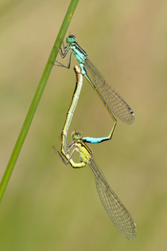
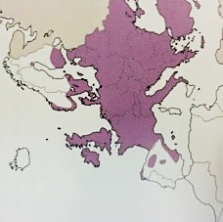
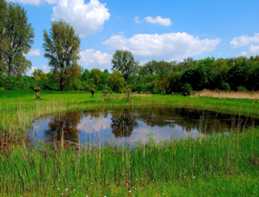
STUDY SPECIES
Ischnura elegans
E: blue-tailed damselfly – NL: lantaarntje
Dragon- and damselflies (Odonata) react strongly to climate change
Common European damselfy living in the vicinity of ponds.
Non-model species
Dijkstra et al. 2006

Slide 30
STUDY SPECIES
Ischnura elegans
Odonata: react strongly to climate change
European damselfy species
Higher thermal optima and faster growth rates at southern latitude
Relatively weak global population structure and high degree of genetic variation within populations
mean F_{ST}value = 0.06
Dijkstra et al. 2006

Slide 31
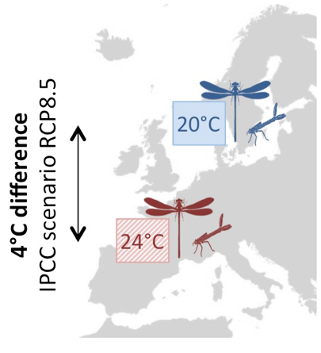
METHODS
Eggs from field
Common garden
SPACE FOR TIME
4°C temperature increase
Latitudinal gradient: 4°C difference
Low-latitude populations used to generate plausible scenarios on trait changes under future warming

Slide 32
METHODS
Eggs from field
Common garden
RNAseq
24 samples (pooled)
3 populations per latitude
2 replicates
2 treatments: 20°C – 24°C
Mild warming

Slide 33
METHODS
Eggs from field
Common garden
RNAseq
Paired-end 100 bp Illumina sequencing
~34–47 million reads per sample
de novo assembly
34,095 high quality contigs
mapping of reads against assembly

Slide 34
INPUT FOR EXERCISE
Eggs from field
Common garden
Detection of differentially expressed genes
Count matrix
level of expression at every contig for all samples
DESeq2 package in R

Slide 35
Assignment
We will be focusing on the last part of the RNA-seq pipeline starting with the count matrix
Go through the DESEQ R script.
Interpret the explorative figures and make VENN diagrams of the contrasts.
Explain how the the populations from the two different latitudes respond differently to a 4°C increase in rearing temperature? How do you explain this? How do you expect populations from the North to cope with rising global temperatures?

